Slide 1

SEMI STRUCTURED DATA MODEL
XML, DTD, XML SCHEMA

Slide 2
DATA MODEL

Slide 3
Definition
Data model defines the data elements and the relationships between the data elements. Data Models are used to show how data is stored, connected, accessed and updated in the database management system.
Data Model gives us an idea that how the final system will look like after its complete implementation.
We use a set of symbols and text to represent the information so that members of the organisation can communicate and understand it.

Slide 4
Types
Hierarchical Model
Network Model
Entity-Relationship Model
Relational Model
Semi-Structured Data Model
Associative Data Model

Slide 5
SEMI STRUCTURED DATA

Slide 6

What is big data?

Slide 7
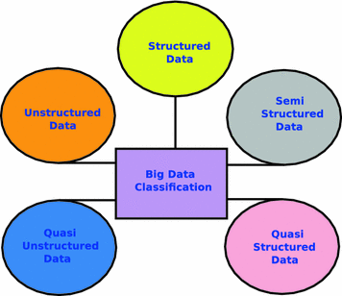
Classification of big data

Slide 8
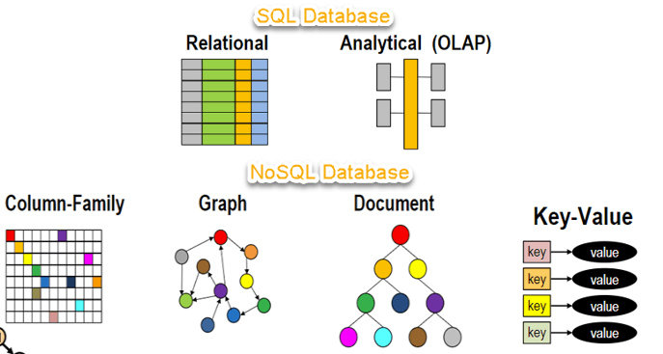
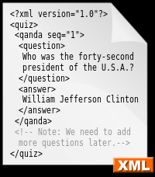
SEMI STRUCTURED DATA

Slide 9
Advantages and disadvantages
ADVANTAGES | DISADVANTAGES
The data is not constrained by a fixed schema | Lack of fixed, rigid schema make it difficult in storage of the data
Schema can be easily changed as it is flexible. | Interpreting the relationship between data is difficult as there is no separation of the schema and the data.
Data is portable | Queries are less efficient as compared to structured data.
Its supports users who can not express their need in SQL

Slide 10
XML
(eXtensible Markup Language)

Slide 11
INTRODUCTION
Extensible Markup Language (XML) is a markup language that defines a set of rules for encoding documents in a format that is both human-readable and machine-readable.
The design goals of XML emphasize simplicity, generality, and usability across the Internet.
It is a textual data format with strong support via Unicode for different human languages.
Although the design of XML focuses on documents, the language is widely used for the representation of arbitrary data structures such as those used in web services.

Slide 12
MARKUP LANGUAGE
A markup language is a computer language that uses tags to define elements within a document. It is human-readable, meaning markup files contain standard words, rather than typical programming syntax. While several markup languages exist, the two most popular are HTML and XML.
XML is a markup language just like HTML(HyperText Markup Language), but with a different purpose.
XML was designed to carry data - with focus on what data is?
HTML was designed to display data - with focus on how data looks?
XML tags are not predefined like HTML tags.

Slide 13
XML Simplifies Things
PLATFORM INDEPENDENT: Many computer systems contain data in incompatible formats. Exchanging data between incompatible systems (or upgraded systems) is a time-consuming task for web developers. Large amounts of data must be converted, and incompatible data is often lost.
DATA TRANSPORT/SHARING: XML stores data in plain text format. This provides a software- and hardware-independent way of storing, transporting, and sharing data.
DATA LOSS: XML also makes it easier to expand or upgrade to new operating systems, new applications, or new browsers, without losing data.
DATA AVAILABILTY: With XML, data can be available to all kinds of "reading machines" like people, computers, voice machines, news feeds, etc.

Slide 14
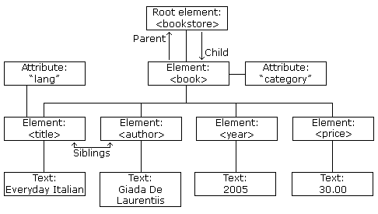
XML STRUCTURE
PROLOG: A prolog defines the XML version and the character encoding.
<?xml version="1.0" encoding="UTF-8"?>
ROOT:
<bookstore>......</bookstore>
CHILD:
<book>……</book>
SUB CHILD:
<title>……</title>

Slide 15
SAMPLE XML CODE
<?xml version="1.0" encoding="UTF-8"?> <bookstore> <book category=“children"> <title lang="en">H. P.</title> <author>J. K. R.</author> <year>2005</year> <price>30.00</price> </book> </bookstore>

Slide 16
DTD
(Document Type Definition)

Slide 17
INTRODUCTION TO DTD:
A DTD stands for Document Type Definition.
A DTD describe XML language precisely , which means DTD defines
1. structure ,
2. legal elements,
3. attributes of an XML document.
DTD syntax: <!DOCTYPE element DTD identifier
[declaration 1,declaration 2]
>

Slide 18
Why Use a DTD?
With a DTD, independent groups of people can agree on a standard DTD for interchanging data.
It gives a way to check the validity of XML files by checking whether the elements appear in the right order, mandatory elements and attributes are in place, the elements and attributes have not been inserted in an incorrect way, and so on.

Slide 19
TYPES OF DTD:
Internal DTD
Elements of DTD are declared within the XML files.
Internal DTD syntax:
<!DOCTYPE root-element [element-decl]>
External DTD
Elements of DTD are declared outside XML file.
External DTD syntax:
<!DOCTYPE root-element SYSTEM “filename”>

Slide 20
DTD BUILDING BLOCKS:
Elements
Attributes
Entities
PCDATA
CDATA

Slide 21
Example of internal DTD:
<?xml version="1.0"?> <!DOCTYPE note [ <!ELEMENT note
(to,from,heading,body)> <!ELEMENT to (#PCDATA)> <!ELEMENT from (#PCDATA)> <!ELEMENT heading (#PCDATA)> <!ELEMENT body (#PCDATA)> ]> <note> <to>Clove</to> <from>Rahul</from> <heading>Reminder</heading> <body>Meet me this weekend</body> </note>
!DOCTYPE note defines that the root element of this document is note
!ELEMENT note defines that the note element must contain four elements: "to,from,heading,body“
!ELEMENT to defines the to element to be of type "#PCDATA“
!ELEMENT from defines the from element to be of type "#PCDATA“
!ELEMENT heading defines the heading element to be of type "#PCDATA“
!ELEMENT body defines the body element to be of type "#PCDATA"

Slide 22
DISADVANTAGES
It does not support the namespaces. Namespace is a mechanism by which element and attribute names can be assigned to groups. However, in a DTD namespaces have to be defined within the DTD, which violates the purpose of using namespaces.
It supports only the text string data type.
It is not object oriented. Hence, the concept of inheritance cannot be applied on the DTDs.
Limited possibilities to express the cardinality for elements.

Slide 23
XML SCHEMA

Slide 24
XML Schema Definition (XSD)
Used to describe and validate the structure and content of XML data
Method of expressing constraints about XML documents
Like DTD but provides more control on XML structure
Standardized XML formats are defined by XML Schemas

Slide 25
More about XSD
Supports Datatypes
Easier to validate correctness of data
Easier to convert data between diffrent datatypes
Uses XML Syntax
No need to learn new language
Secure Data Communication
03-11-2004 as 11.March or 3.Nov
Datatype date requires format YYYY-MM-DD

Slide 26
Definition Types
Simple Type
Complex Type
Used only in the context of the text
Eg
<xs:element name = “Phone” type = “xs:int”/>
Container for other element
Definition allows you to specify which child elements an element can contain and to provide some structure within your XML documents.

Slide 27
Example of Complex Types
Example.xml
Example.xsd
<?xml version=“1.0” encoding=“UTF-8”?>
<Address
xsl:schemalocation=“Example.xsd”>
<Name>Abhi</Name>
<Phone>9130</Phone>
</Address>
<?xml version=“1.0” encoding=“UTF-8”?>
<xs:Schema xmlns:xs=“Schemalocation”>
<xs:element name=“Address”>
<xs:Complex TYpe>
<xs:Sequence>
<xs:element name=“Name” type=“xs:String”/>
<xs:element name=“Phone” type=“xs:int/”>
</xs:Sequence>
</xs:Complex type>
</xs:element>

Slide 28
Difference between DTD and XSD
Document Type Definition (DTD)
XML Schema definition (XSD)
Doesn’t support Datatypes
Doesn’t support namespace
Doesn’t define Order for child elements
Non extensible
Supports Datatypes
Supports Namespace
Order can be defined
Extensible

Slide 29
Difference(contd.)
DTD
XML schema
Eg
<!DOCTYPE Address[
<!Element Address(Name)>
<!Element Name(#PCDATA)>
]>
Eg
<xs:element name=“Address”>
<xs:Complex TYpe>
<xs:Sequence>
<xs:element name=“Name” type=“xs:String”/>
<xs:element name=“Phone” type=“xs:int/”>
</xs:Sequence>
</xs:Complex type>
</xs:element>

Slide 30
THANK YOU

